Slide 1
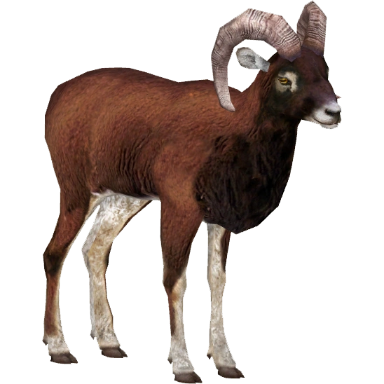

Multivariate immune defences and fitness in the wild
Data Mining, Modeling and Biostatistics
April 15, 2024.
Team members:
Arthickah Praveen
Sandra Garcia

Slide 2


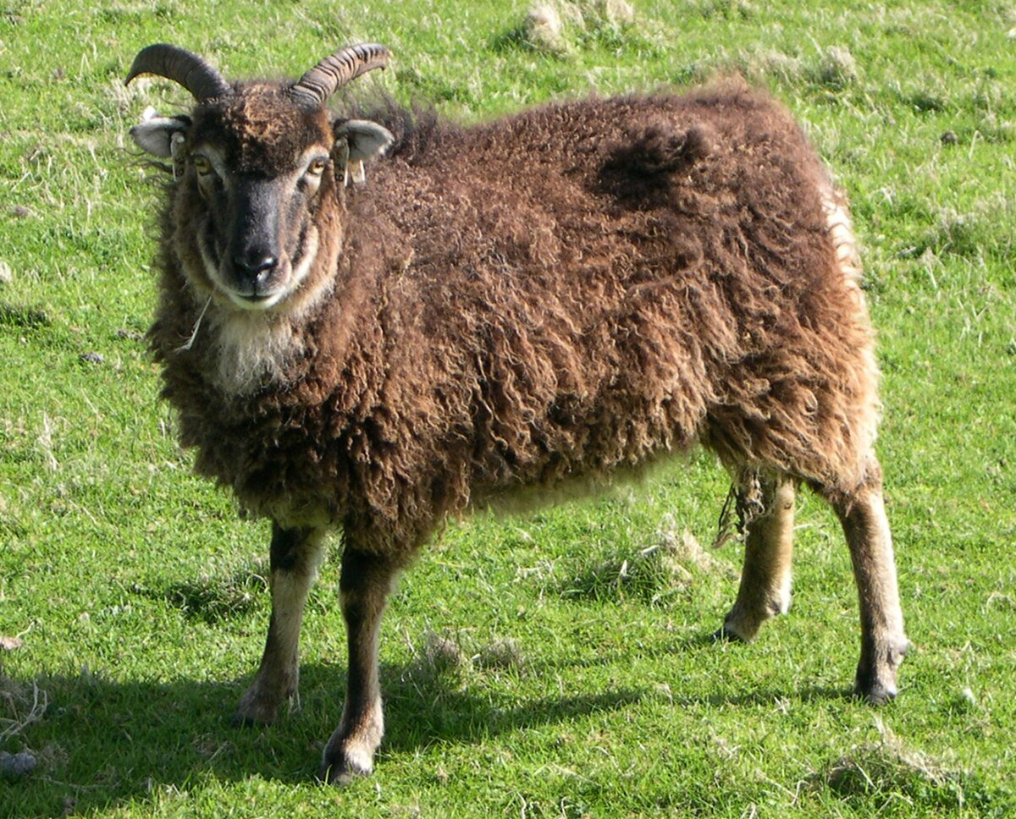
INTRODUCTION
The nursey2014 dataset (Nussey et al., 2014) examines immune function and fitness in wild Soay sheep from St. Kilda. It includes:
Antibody levels (IgA, IgM, IgG)
Body condition (weight, parasite burden)
Fitness outcome (over-winter survival)
Context:
Harsh environment: parasites, food scarcity
Juvenile survival is crucial for population persistence
IgA and IgM aid immune defense; IgG is key for systemic protection

Slide 3
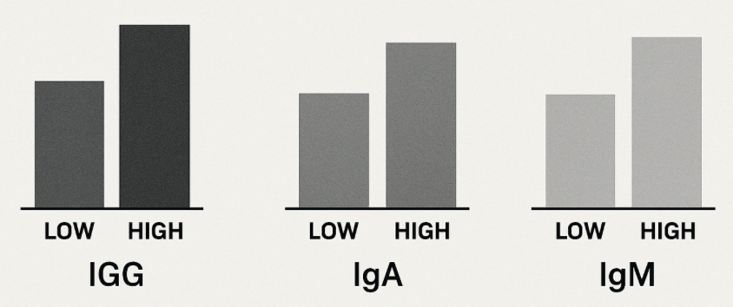

RESEARCH QUESTION
Among juvenile Soay sheep, does immunoglobulin G (IgG) level demonstrate a stronger association with survival to adulthood than immunoglobulin A (IgA) or immunoglobulin M (IgM) levels?

Slide 4

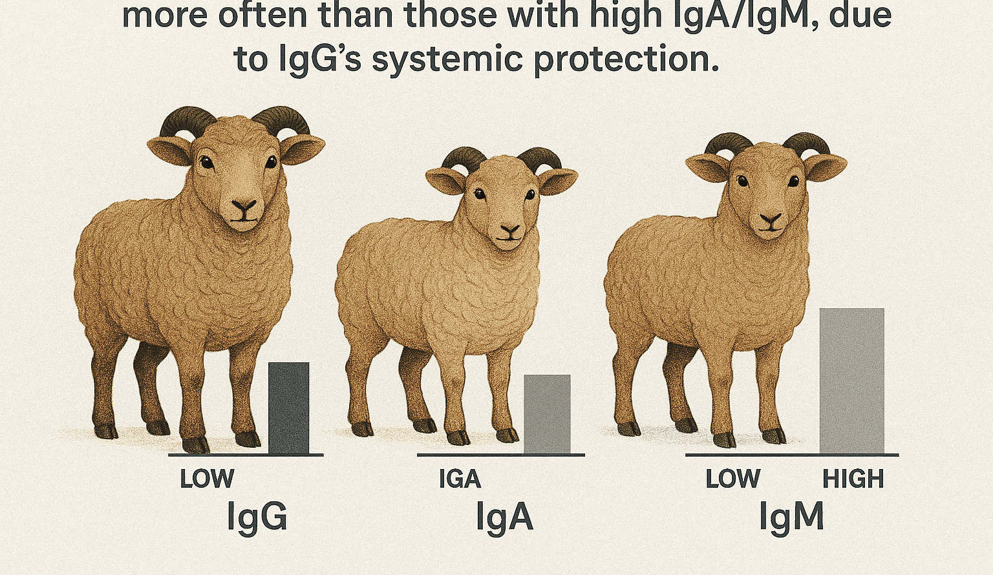
HYPOTHESIS
"Juvenile sheep with higher IgG levels will survive more often than those with high IgA/IgM, due to IgG’s systemic protection."

Slide 5
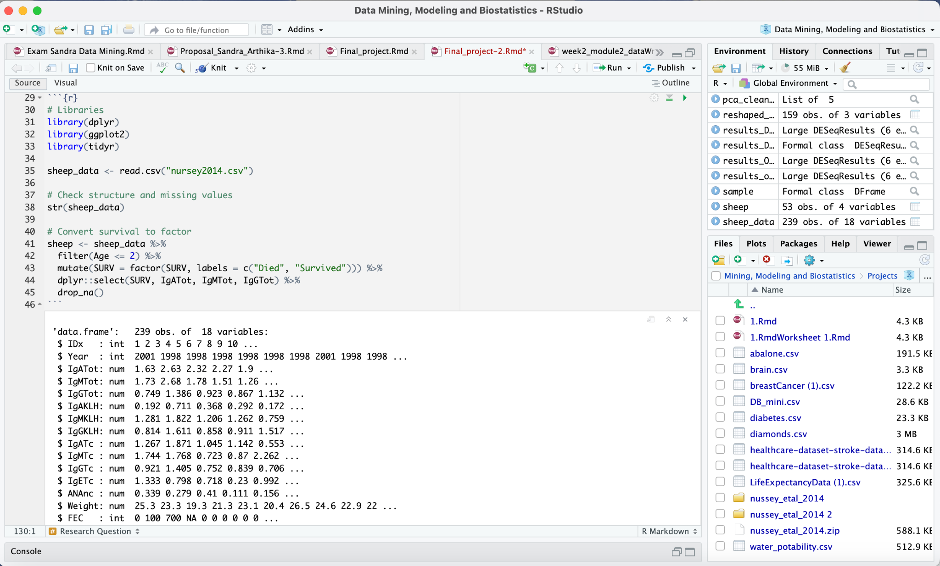

Data Exploration & Cleaning
Key steps:
Filtered juveniles (Age ≤ 2).
Converted SURV to factor (Died/Survived).
Selected relevant columns (antibodies + survival).
Dropped NAs (no severe missingness).
Observations
- No severe missingness in survival or antibodies (IgATot, IgMTot, IgGTotc)
- New column named "SURV" created comprising died/survived for easy readability

Slide 6
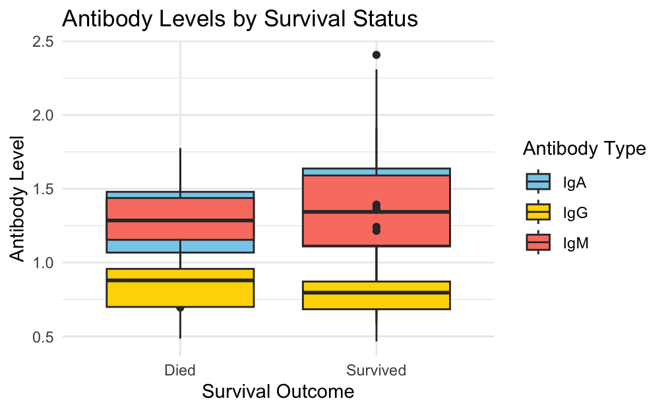
General Visualization
Initial box plots suggest IgG levels are more separated between survivors and non-survivors than IgA/IgM, hinting at IgG’s predictive power.

Slide 7
Reshaping & GLM Setup
To compare antibodies, we reshaped the data into a long format, allowing us to test all three types in one model
Transformed data from columns (IgA, IgM, IgG) → rows for GLM comparison.
Wide Format (Original)
SURV | IgMTot | IgATot | IgGTot
Survived | 1.90 | 1.37 | 1.07
Long Format (Reshaped)
SURV | Antibody | Values
Survived | IgMTot | 1.90
Survived | IgAtot | 1.37

Slide 8
Summary of generalized linear model
Effect | Coefficient (Estimate) | Meaning | Statistically Significant? (p < 0.05?)
Baseline (IgA at 0 levels) | -0.01 (Intercept) | Survival odds when IgA levels = 0 (neutral starting point). | ❌ No (p = 0.99)
IgA level increase | 0.63 | IgA level starts with slightly higher survival (weak positive) | ❌ No (p = 0.45)
IgG vs. IgA (at 0 levels) | 0.79 | IgG starts with slightly higher survival odds than IgA at 0 levels. | ❌ No (p = 0.64)
IgM vs. IgA (at 0 levels) | 0.22 | IgM starts with very slightly higher survival odds than IgA at 0 levels. | ❌ No (p = 0.89)
IgG level increase | -0.55 (Interaction) | IgG’s benefit weakens by 0.55 per unit vs. IgA (high IgG may not help). | ❌ No (p = 0.73)
IgM level increase | -0.16 (Interaction) | IgM’s benefit weakens by 0.16 per unit vs. IgA (almost no difference). | ❌ No (p = 0.90)

Slide 9

Antibody Survival Effects (GLM Results):
Top Findings Box:
No antibody shows significant effect on survival (p value > 0.05)
Null deviance (DF = 158):We started with 159 sheep (DF = n−1 = 158).
Residual deviance (DF = 153):
The model used 5 pieces of info (DF lost = 158−5) to test:
3 antibody types (IgA, IgG, IgM)
2 interactions
.

Slide 10
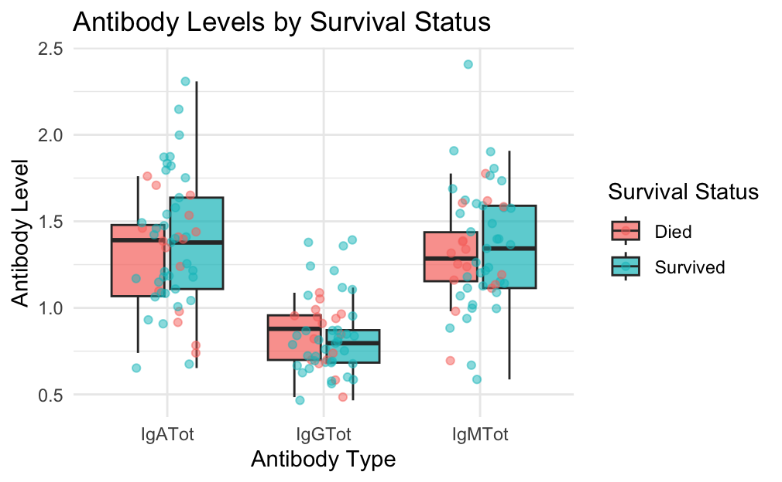
Visualization through box plot
Interpretation:
This plot confirms IgG’s stronger separation between outcomes, though overlap suggests other factors may be at play..

Slide 11
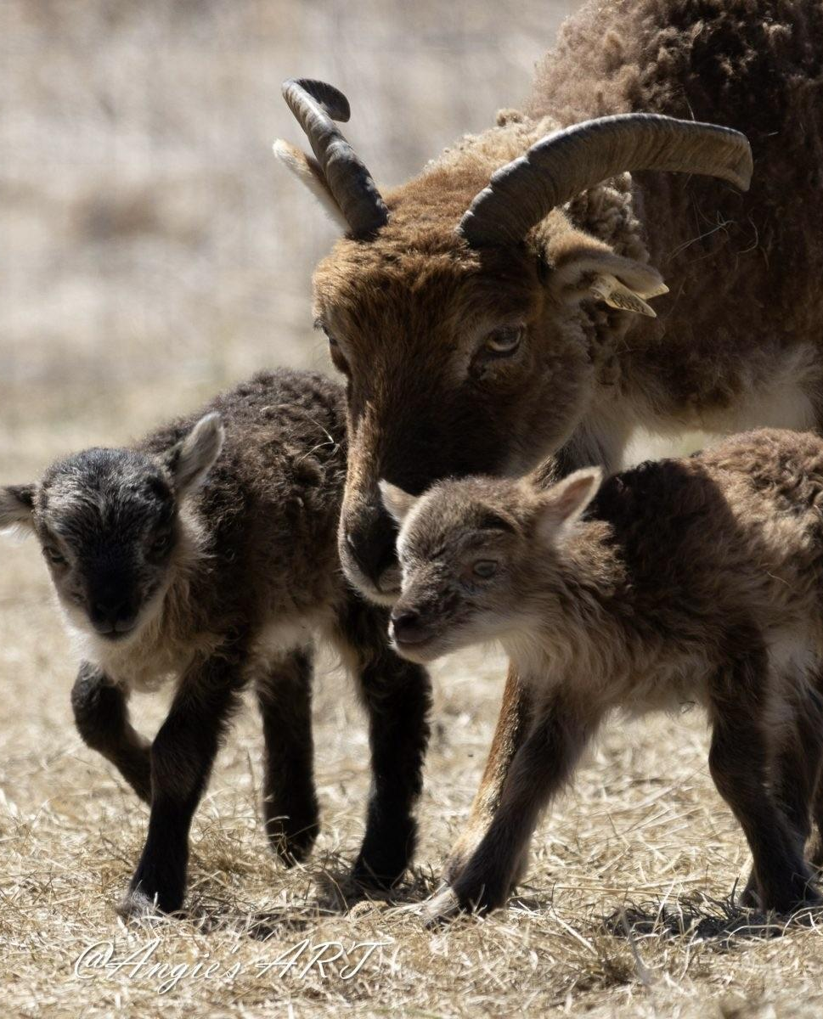
Limitations
Sample size: 159 sheep may lack power to detect small effects
Confounding factors: Unmeasured parasite load (FEC) and nutritional status may influence results
Temporal mismatch: Summer antibody levels may not reflect winter survival conditions
Future Research direction
Control for parasite burden and body condition
Increase sample size for more robust detection of effects
Longitudinal antibody measurements across seasons

Slide 12
Rerefences
Nussey, D. H., Watt, K. A., Clark, A., Pilkington, J. G., Pemberton, J. M., Graham, A. L., & McNeilly, T. N. (2014). Multivariate immune defences and fitness in the wild: complex but ecologically important associations among plasma antibodies, health and survival. Proceedings of the Royal Society B, 281(1785), 20132931.
R Core Team (2023). R: A language and environment for statistical computing. R Foundation for Statistical Computing, Vienna, Austria. URL https://www.R-project.org/.

Slide 13

Thanks!
Do you have any questions?

